Slide 1
Chapter 3 (Part – 2) DISK OPERATING SYSTEM (DOS)

Slide 2
DISK OPERATING SYSTEM (DOS)
DOS stands for Disk operating system.
It is used for abstraction and management of secondary storage devices of the computers and the information stored there.
HISTORY
In early days of computers, there were no disk drives; instead magnetic tapes, punched cards etc. were used. After creation of hard disks and floppy disks, the need of a software for managing rapid access to block storage of sequential and other data became inevitable. So, DOS was developed.

Slide 3
DOS FUNCTIONS
To manage disk files.
To allocate system resources according to the requirement.
To provide features essential to control hardware devices such as Keyboard, Screen, Disk Devices, Printers, Modems and programs.

Slide 4
NAMING THE FILES IN DOS
DOS permits the user to assign a name consisting of two parts to a filename - primary & secondary names.
Primary can consist of 8 characters while secondary can consist of 3 characters. Both names are separated by a dot (.)
For Example: Bioedit.exe

Slide 5
DIRECTORY STRUCTURE IN DOS
DOS files are organized in a hierarchical or inverted tree-like structure. The general analogy is with a file cabinet having a no. of drawers, which in turn may contain folders that may contain info.
The file cabinet in DOS is the ROOT DIRECTORY, the drawer is INDIVIDUAL DIRECTORY, the folders are SUB-DIRECTORY and the info contained in these files may be termed as FILES.

Slide 6
TYPES OF DOS
Following are the major types of DOS Command:
External dos commands which are used separately to perform specific task or operation. Internal dos commands are those commands which are included in command processor (command.com). For example: FORMAT, DISKCOPY, etc
Internal dos commands are built in command.com file and while the computer has been booted this file or commands are loaded in the computer memory and you can use this basic dos commands while computer is ON. For example: DEL, COPY, TYPE, etc.

Slide 7
INTERNAL DOS COMMAND
CHANGE DIRECTORY(CD) Command
This command enables to change the current directory or, in other words, to navigate to another folder from the PC.
Syntax C:> cd\ (Press Enter)

Slide 8
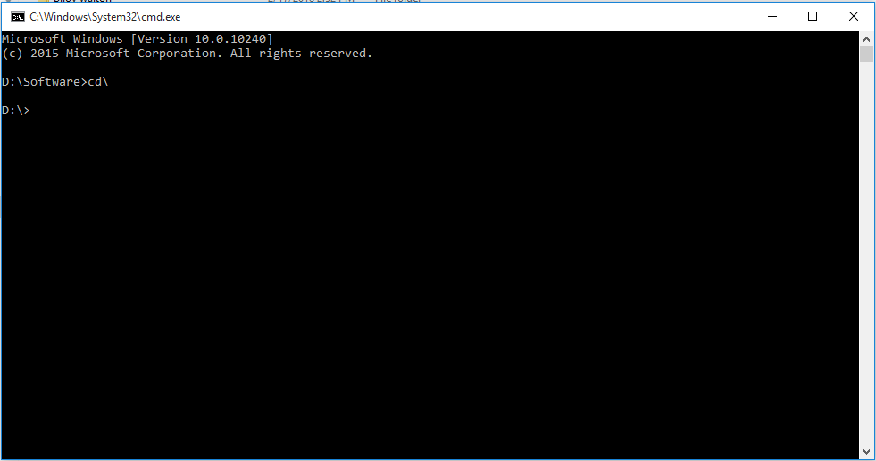
CHANGE DIRECTORY(CD) Command

Slide 9
INTERNAL DOS COMMAND
DIRECTORY(DIR) Command
dir (directory) is a command in various computer operating systems used for computer file and directory listing. It is one of the basic commands to help navigate the file system
Syntax C:> dir (Press Enter)

Slide 10
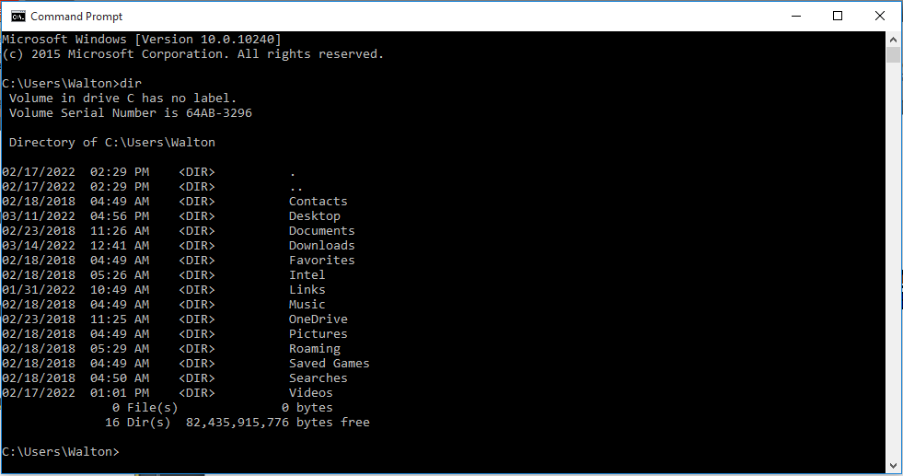
DIRECTORY(DIR) Command

Slide 11
INTERNAL DOS COMMAND
MAKE DIRECTORY(MKDIR) Command
MKDIR (Make Directory) or the MD command is used to make new folder or directory.
Syntax C:> mkdir folder name(Press Enter)
Or
C:> md folder name(Press Enter)

Slide 12
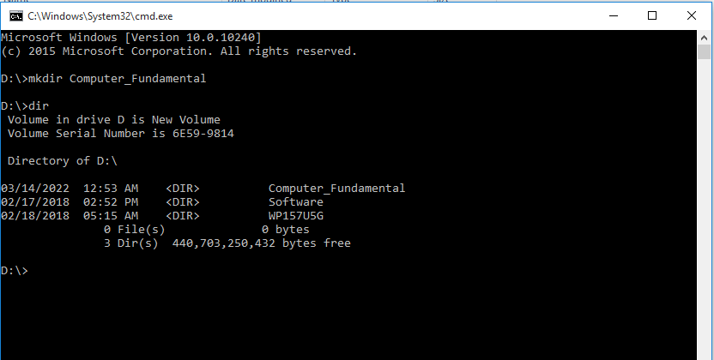
MAKE DIRECTORY(MKDIR) Command

Slide 13
INTERNAL DOS COMMAND
Rename DIRECTORY(REN) Command
REN command is used to rename the directory or folder.
Syntax C:> ren folder-name new-folder-name(Press Enter)

Slide 14
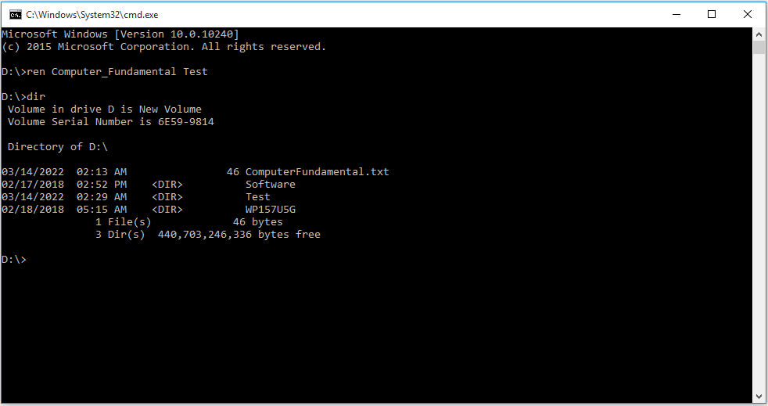

Slide 15
INTERNAL DOS COMMAND
REMOVE DIRECTORY(RMDIR) Command
RMDIR (Remove Directory) is used to remove or delete the folder or directory.
Syntax C:> rmdir /s folder-name (Press Enter)

Slide 16
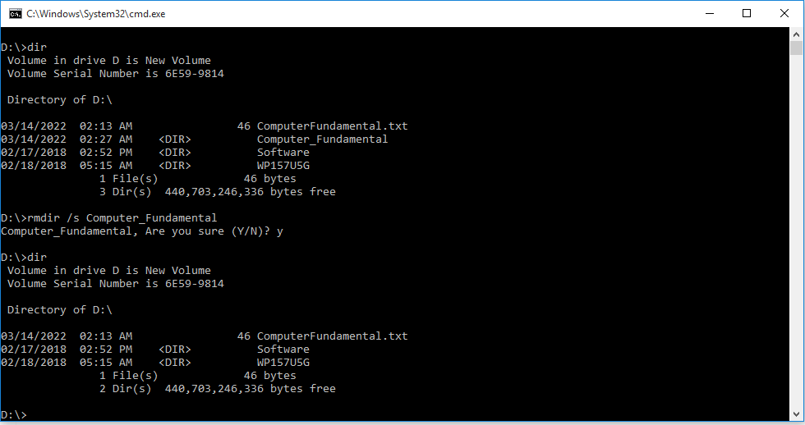

Slide 17
INTERNAL DOS COMMAND
CLS Command
This is an Internal dos command which is used to clear the output on the screen obtained when executed any basic dos commands.
These commands clears all the text from the screen and shows user a Command prompt.
Syntax C:\>cls (Press Enter)

Slide 18
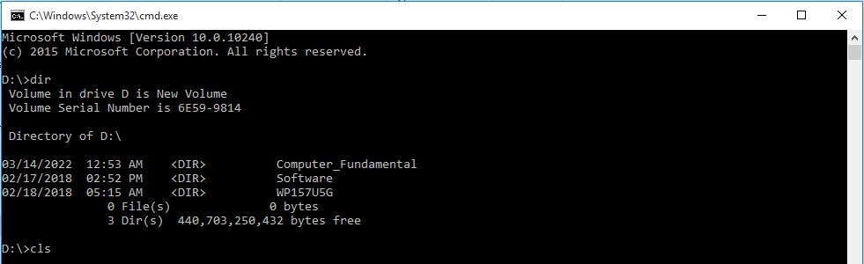
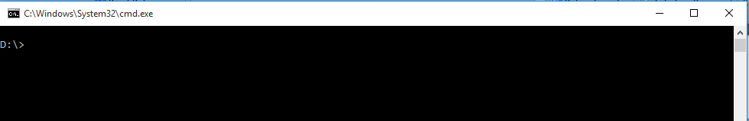
CLS Command
After pressing enter, all the output are cleared.

Slide 19
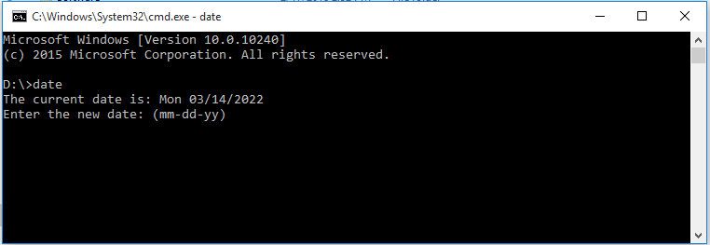
INTERNAL DOS COMMAND
DATE Command
Date command is a internal basic dos command which is used to display or change current date of system in format of mm/dd/yy.
Syntax C:\>date (Press Enter)

Slide 20
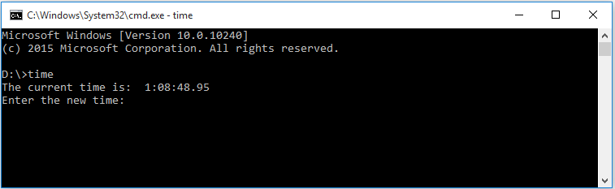
INTERNAL DOS COMMAND
TIME Command
Time command is used to display or change the current time of Computer system. The format which is used by time command is HH:MM:SS .Where HH stands for hours of the day in 24 hour format , MM for minutes , SS For seconds and CC For hundreds of a second.
Syntax C:\>time (Press Enter)

Slide 21
INTERNAL DOS COMMAND
COPY CON Command
This is a very important internal dos command which is used to create text files . The filename used while creating a file using this basic dos command consist of a primary name and a extension which is separated by a dot or commonly called as period.
While creating a File there are some rules, that a primary file name must not be greater then 8 characters and the extension must be not greater then 3 characters.
Filename can consist of digits and special symbols such as 0 to 9 or @ # % etc
For more internal DOS command
https://www.youtube.com/watch?v=6EQPJ4rS6W0
Syntax C:\>copy con FileName (Press Enter)
Every body wants to go to heaven but nobody wants to die.
To save the file use CTRL+Z OR F6 OR to cancel use CTRL+C from keyboard.

Slide 22
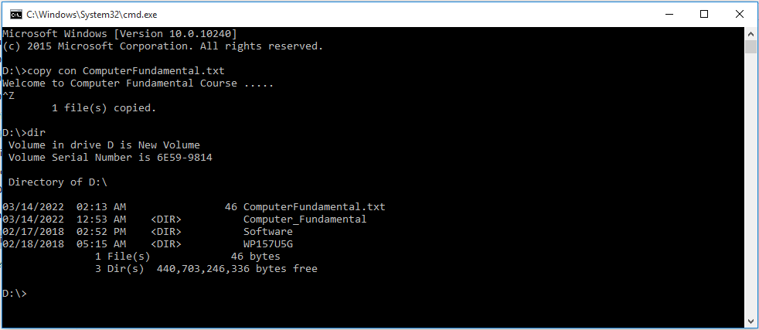
COPY CON Command

Slide 23
INTERNAL DOS COMMAND
COPY Command
This command is used to copy file.
Syntax C:\>copy original-filename new-filename(Press Enter)

Slide 24
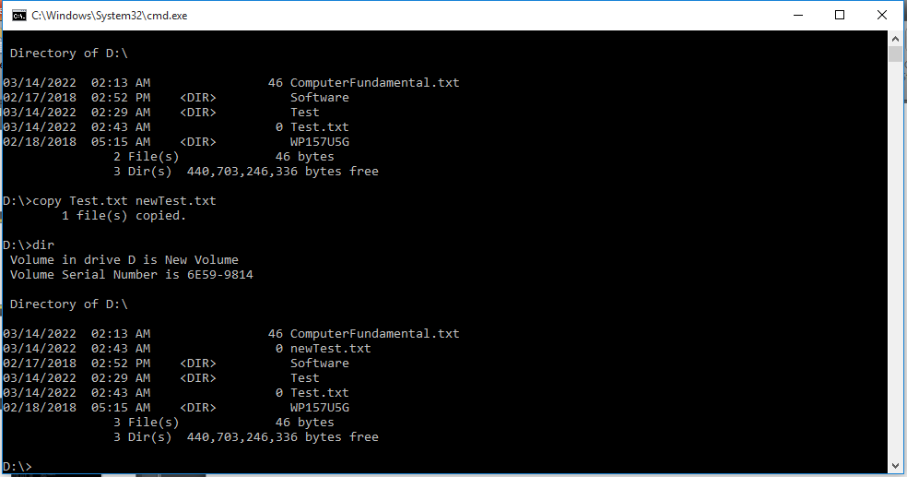

Slide 25
INTERNAL DOS COMMAND
RENAME (REN) Command
This command is used to rename a file.
Syntax C:\>rename original-filename new-filename(Press Enter)
Or
C:\>ren original-filename new-filename(Press Enter)

Slide 26
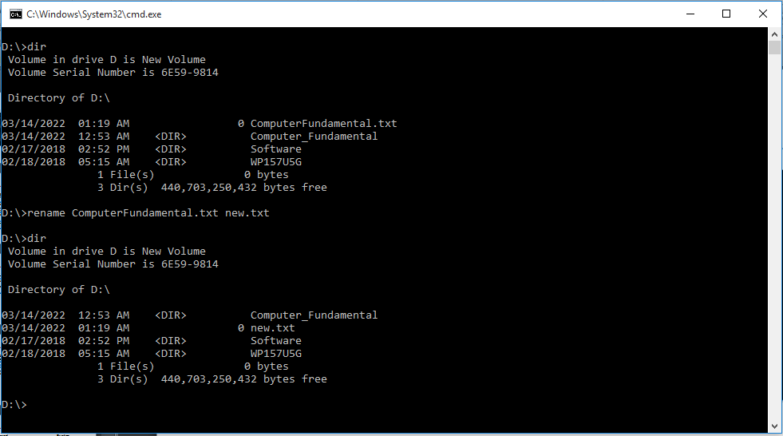
RENAME (REN) Command

Slide 27
INTERNAL DOS COMMAND
Delete (del) Command
This command is used to delete a file.
Syntax C:\> del fie-name (Press Enter)

Slide 28
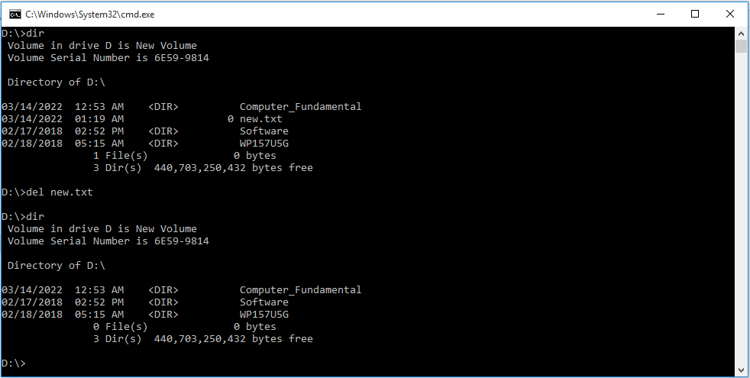
INTERNAL DOS COMMAND
DELETE (DEL) Command
This command is used to rename a file.
Syntax
C:\>del filename (Press Enter)

Slide 29
EXTERNAL DOS COMMAND
FORMAT Command
Format command is a external command and to run format command you need a supporting file named format.com
Format command deletes or erase all the data present in the drives . which can be any flash drives , hard drives or floppy disk.
The format command creates new allocation table and root directory and make the drive use able. The command also checks for bad areas of drives commonly called as bad sectors.
Syntax C:> format (drive name) (Press Enter)
C:>format A: (Press Enter)
Switches used in format command.

Slide 30
EXTERNAL DOS COMMAND
DISKCOPY Command
DISKCOPY is a basic dos commands which comes in a category of external dos command which is used to copy entire content of one drive to another .
Diskcopy command works only with floppy disk.
Syntax C:>Diskcopy A: B:
(Press Enter)

Slide 31
EXTERNAL DOS COMMAND
XCOPY Command
XCOPY DOS COMMAND is used to copy entire files , directories and subdirectories from one location to another.
xcopy command is executed when xcopy.exe file is present in hard disk or bootable drive .
Syntax C:>xcopy(source) (destination) (Press Enter)
Example:
C:>xcopy/s/e c:movies d:new (Press Enter)
In the Example xcopy will copy all files and directories from c:movies to d:new .where /s is used for copying nonempty subdirectories.
And /e is used for copying directories and subdirectories including empty ones. Switches used in XCOPY COMMAND.use xcopy/? To know all the switches used.

Slide 32
EXTERNAL DOS COMMAND
SYS Command
SYS COMMAND is another external dos command which is used to transfer system files into destination drive and make the drive bootable .
Usually sys commands copy three files namely command.com,io.sys and msdos.sys.
For more external DOS Command
https://www.youtube.com/watch?v=_8vkSneFcsw
Syntax C:> sys a: (Press Enter)
A:> sys c: (Press Enter)

